Slide 1
160M - Gavel Grow Investments Foundation
Global Growth – Together We Can – Build Investment for the Future

Slide 2
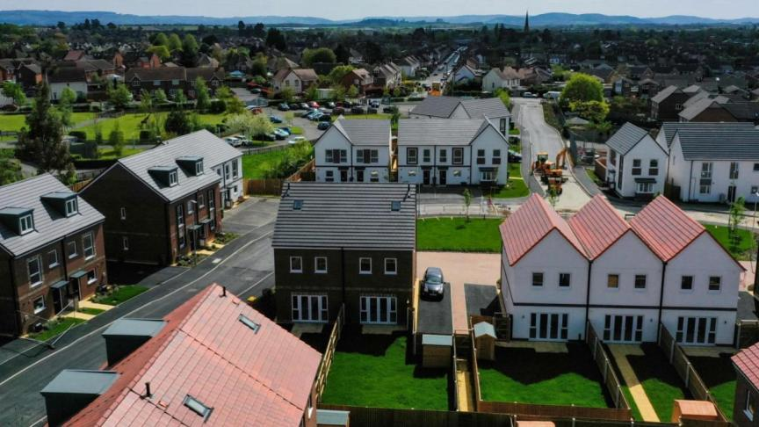
Problem Statement
Problem: Limited access to diversified high-growth investment opportunities.
Market Need:
Auctions: Need for modern, integrated platforms that combine online and traditional auctions.
Real Estate: High demand for premium properties in strategic locations like London and Newark is unmet.
Agriculture: Increasing global demand for sustainable and efficient farming practices.
Market Size:
Global agriculture market: $5 trillion
Auction market: $500 billion
Real estate market in London: £50 billion

Slide 3

Solution
Our Solution: Gravel Grow Investments offers a diversified portfolio across agriculture, auctions, and real estate.
Auctions: Innovative auction platforms such as “World of Auctions” and “Palace Auctions London.”
Real Estate: Acquisition and development of premium properties in high-demand areas like London, Newark and the UK.
Agriculture: Investment in sustainable farming practices and high-quality livestock.
Uniqueness and Competitive Advantage:
Integrated Approach: Combines traditional and modern investment avenues for diversified risk and return.
Experienced Management: A proven track record of success in each sector.
Diversification: Minimizes risk and maximizes growth potential through a diversified investment portfolio.

Slide 4
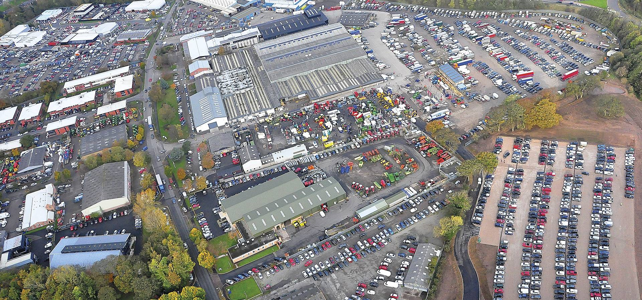
Market Opportunity
Target Market: High Net Worth Individuals (HNWIs) and Institutional Investors
Market Size: HNWIs globally: 22 million with combined wealth of over $60 trillion.
Growth Potential:
Auctions: Increasing online auction market share, expected to grow at 8% CAGR.
Real Estate: London property market projected to grow by 5% annually.
Agriculture: Projected CAGR of 4.1% over the next decade.
Expansion Opportunities: Geographic expansion, additional asset acquisitions, and increased market penetration.

Slide 5
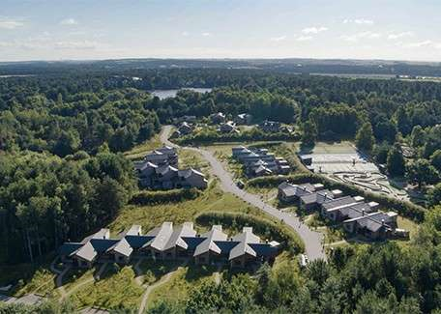
Business Model
Revenue Streams:
Real Estate: Rental income, property appreciation, and sales of developed properties.
Auctions: Commission from auction sales, listing fees, and premium memberships.
Agriculture: Revenue from beef and lamb production, livestock sales, and farm produce.
Pricing Strategy:
Shares: £400 per B class share.
Auctions: Competitive commission rates and premium service charges.
Real Estate: Market-driven pricing for sales and rentals.
Income Projections:
Year 1 Revenue: £161 million
Year 2 Revenue: £168 million, with significant growth expected in auction and real estate sectors.

Slide 6
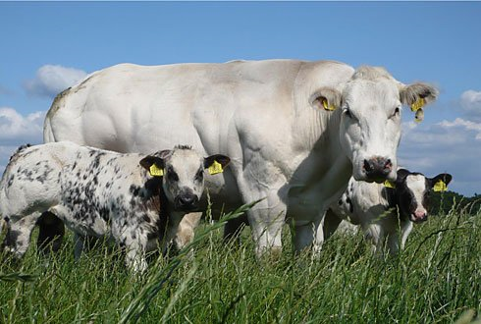
Traction
Key Milestones:
Auctions: Launched “World of Auctions” platform with 10,000 active users.
Real Estate: Purchased and developed 10 properties in London and Newark.
Agriculture: Acquired 500 acres of farmland and 200 high-quality livestock.
Achievements:
Partnered with leading agricultural technology firms.
Secured exclusive auction rights for high-value items.
Achieved 95% occupancy rate in developed properties.
Metrics:
User Growth: 50% month-over-month increase for auction platform.
Revenue Growth: 30% increase in agricultural revenue in the past year.
Real Estate Appreciation: 15% increase in property values over the past year.

Slide 7

Financials
Revenue Projections:
Year 1: £161 million
Year 2 increasing to : £168 million
Year 3 increasing to : £200 million
Key Financial Metrics:
Customer Acquisition Cost (CAC): £400
Lifetime Value (LTV): £5000
Burn Rate: £11.5m, with the individual burn rates
2024 / 2025 ranging from £450,000 to £6M
Fund Utilization:
Auction Platform & Commercial Developments:£30 million
Real Estate Acquisitions: £60 million
Agriculture Expansion: £50 million
Marketing and Sales: £20 million

Slide 8

Team
Management Team:
CEO: Penny Swindells, an 82-year-old seasoned business leader with a rich history in Auctions farming and estate management, currently oversees the Group as the guiding eye.
CFO: Tom D Barrett is former corporate retail sales professional with four years in the group, is a key player in progressing every sale from agreement to completion. Tom holds a 10% share and directorships in The World of Auctions and Palace Auctions."
COO: Edward R Swindells, Auctioneer, is a strategic planner and operational decision-maker in the business, with a track record of overcoming challenges, multiple national auctioneer awards, and significant roles in resolving highly complexed business cases.
Relevant Experience:
Successful exits from previous ventures.
Extensive network of industry connections.
Proven track record in driving growth and profitability.

Slide 9

Competitive Landscape
Competitors
Auctions: Global Auctions, E-Auctions Inc.
Real Estate: Prime Realty, Urban Developers.
Agriculture: Big Agri Co, Farm Pro.
Unique Positioning
Integrated Approach: Diversified portfolio spanning multiple high-growth sectors.
Technology-Driven: Leveraging technology to enhance auction, commercial property and agricultural operations.
Experienced Team: Deep industry knowledge and proven track record.

Slide 10

Marketing and Sales Strategy
Customer Acquisition
Digital Marketing: Targeted online ads and social media campaigns.
Partnerships: Collaborations with industry leaders and influencers.
Events: Hosting and participating in industry events and expos.
Customer Retention
Premium Services: Offering exclusive services and memberships.
Loyalty Programs: Incentives for repeat customers and referrals.
Distribution Channels
Online: Dedicated websites and online platforms.
Offline: Physical offices and direct sales teams.
Marketing Tactics:
Content marketing, email campaigns, and SEO optimization.

Slide 11

Fundraising Details
Amount to Raise: £160 million
Fund Allocation:
Auction site and commercial Development: £30 million
Real Estate Acquisitions: £60 million
Agriculture Expansion: £50 million
Marketing and Sales: £20 million
Expected Outcomes
Significant increase in revenue and market share.
Enhanced technological capabilities and operational efficiency.
Expansion into new markets and acquisition of strategic assets.

Slide 12

Timeline
Roadmap:
Q3 2024: Complete fundraising and begin agricultural expansion.
Q4 2024: Launch upgraded auction platform and acquire additional properties.
Q1 2025: Scale marketing efforts and increase customer acquisition.
Q2 2025: Expand into new geographic markets and enhance service offerings.
Q3 2025: Achieve significant revenue growth and market penetration.
Utilization of Funds: To achieve key milestones and drive growth.

Slide 13
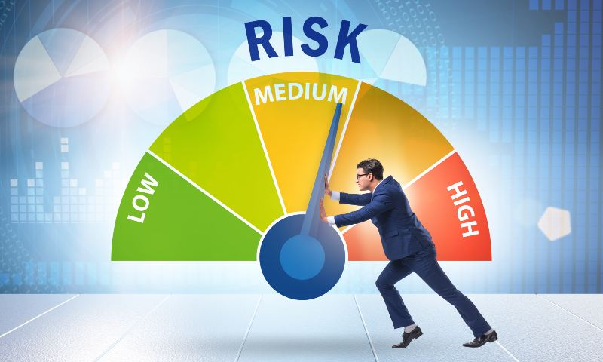
Risks and Mitigation
Potential Risks
Market Volatility: Economic fluctuations impacting revenue.
Regulatory Changes: Changes in laws and regulations affecting operations.
Operational Challenges: Logistical and operational difficulties in scaling.
Mitigation Strategies
Diversification: Spread investments across multiple sectors to mitigate risk.
Compliance Team: Dedicated team to ensure adherence to regulations.
Operational Efficiency: Implement advanced technology and processes to streamline operations.

Slide 14

Contacts
Office Address:
The Gavel Growth Foundation 12 Old Bond St, London W1S 4PW
Office Hours: 8am to 7pm (UK time) Monday – Saturday
Tel 1: 0207 101 3647
Tel 2: 07971 033276
E-Mail 1: Tom@palaceauctions.com
E-mail 2: Edward@worldofauctions.co.uk
Website: https://worldofauctions.co.uk

